Slide 1
Anti-Emetics
Complete List
MOA | Drugs
5-HT3 Antag | Dolasetron Granisetron Ondansetron Palonosetron Mirtazapine
DA antagonist | Domperidone Olanzapine Droperidol Haloperidol Chlorpromazine Promethazine Prochlorperazine
NK1 receptor Antagonist | Aprepitant (Emend)
H1 Antag | Diphenhydramine (Benadryl) Dimenhydrinate Doxylamine Promethazine
Cannabinoids | Drobinol (Marinol)
BZP | Lorazepam
Anti-Cholinergics | Hyoscine
Steroids | Dexamethasone

Slide 2

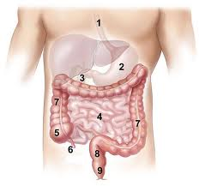
Cause of Emesis
Treat Emesis
Cortical (higher brain)
Chemo Trigger Zone
(Medulla)
BZP, Cannabinoids
Metoclopramide
Phenothiazines
Haloperidol
Droperidol
Aprepitant
Vestibular (ear)
Anti-Cholinergics
H1 antag
GI tract
(Visceral Afferents)
5-HT3
Notes:
Metoclopramide blocks DA

Slide 3
Location | Drugs | Use
Cortical (higher brain) | BZP Cannabinoids | Anticipatory N/V due to anxiety
Chemo Trigger Zone (Medulla) | Metoclopramide Haloperidol Phenothiazines Aprepitant | Rescue Emesis (DA anTAGonist) All cisplatin should be given Aprepitant
Vestibular (Ear) | Anti-Cholinergics H1 antag | Mild Emesis
GI tract (Visceral Afferents) | 5-HT3 | Acute Emesis and Prevention Dose 30 min before chemo Steroids increase efficacy by 20%
Notes:
17

Slide 4
Classification of Chemotherapy
 | Level 1 | Level 2 | Level 3 | Level 4 | Level 5
% of emesis | < 10% | 10 – 30% | 30 – 60% | 60 – 90% | 90%
Drugs | Bevacizumab Bleomycin Busulfan Cladribine Cetuximab Fludarabine Rituximab Vinblastine s Vincristine Vinorelbine | 5-Fluorouracil Bortezomib Cabazitaxel Cytarabine ≤ 1g/m2 Docetaxel Etoposide IV Gemcitabine Liposomal doxo Methotrexate Mitomycin Mitoxantrone Paclitaxel Panitumumab Pemetrexed Topotecan Trastuzumab | Alemtuzumab Bendamustine Carboplatin Cyclophosphamide <1500 mg/m2 Cytarabine ≥ 1g/m2 Daunorubicin Doxorubicin Epirubicin HD methotrexate >250mg/m2 idarubicin Ifosfamide Irinotecan Oxaliplatin | Same as 3 | Carmustine Cisplatin Cyclophosphamide ≥ 1500 mg/m2 Dacarbazine Mechorethamine

Slide 5
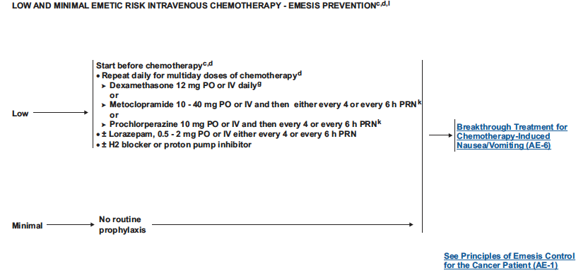
Level 1: Low risk = No Tx
Level 2: Low Risk

Slide 6
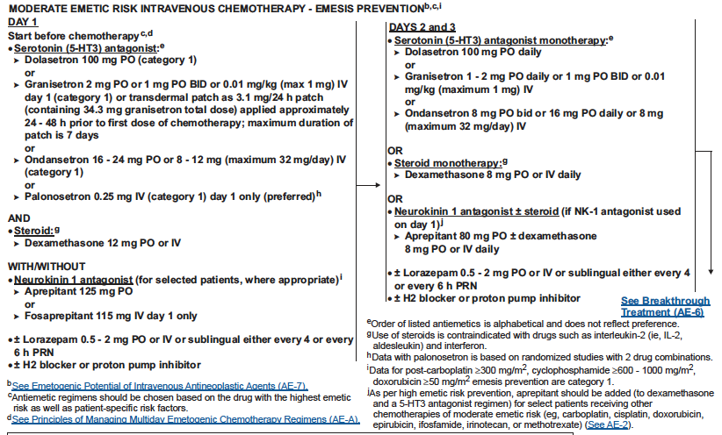
Level 3, 4: Moderate risk

Slide 7
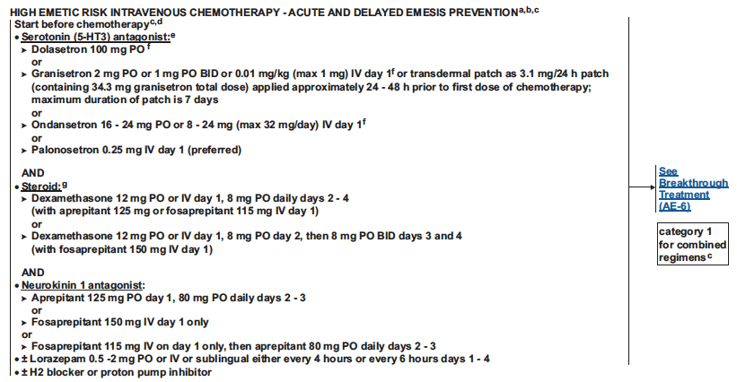
Level 5: high Risk

Slide 8
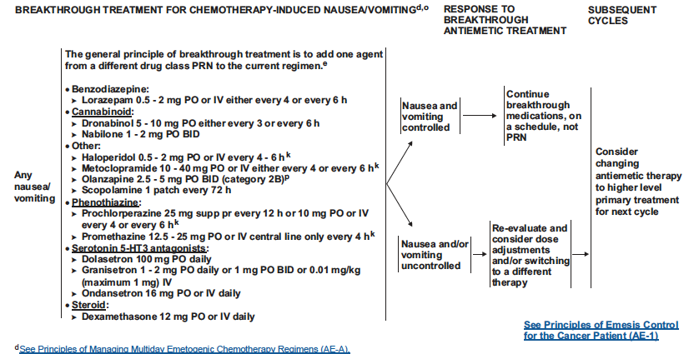
Breakthrough treatment

Slide 9
Rescue Treatment: When prophylaxis fails:
Drug | PO | Vomiting Patient
Metoclopramide | 10 mg QID | 10 – 20 mg IV
Haloperidol | 0.5 – 1 mg q6h | 1- 3 mg IV/IM
Prochlorperazine | 10 mg QID | 10 mg IV
Dronabinol | 5 mg TID | ---
Nabilone | 1 mg BID | ---
Dexamethasone | --- | 10 – 20 mg IV
Lorazepam | --- | 1 – 2 mg IV/ML/SL
Do NOT use the Aprepitant nor 5-HT3 antagonists for rescue.

